Slide 1
Challenges Facing Community Colleges
Need for policies and practices that ensure student success
Increased demand on the system. In the last 15 years, enrollment has grown 44%
Substantially reduced resources. 47% of CCC students report they cannot enroll in needed classes, compared to 28% nationwide
Unacceptable completion rates. Of the 18% of students who begin one level below transfer-level, only 42% ever achieve a certificate, degree, or transfer preparation

Slide 2
Taking Action Now Creation of the Student Success Task Force
Pursuant to Senate Bill 1143, the California Community Colleges Board of Governors (BOG) established the Student Success Task Force
The Task Force Goal was to examine best practices and models for accomplishing student success and present recommendations
The Task Force was composed of 20 members from a diverse group of internal and external stakeholders

Slide 3
Refocusing California Community Colleges toward student success
This comprehensive plan to improve the System’s capacity to serve students:
Would rebalance priorities within the community college system to better focus on the core missions of workforce preparation and transfer, while protecting access
Would make community colleges more responsive to the needs of students and the economy
Would increase student success rates for certificate and degree completion and transfer to four-year institutions

Slide 5
Recommendations Overview 8 areas of focus with 22 recommendations
Increase college and career readiness
Strengthen support for entering students
Incentivize successful student behaviors
Align course offerings to meet student needs
Improve education of basic skills students
Revitalize and re-envision professional development
Enable efficient statewide leadership and increase coordination among colleges
Align resources with student success recommendations

Slide 6
Key Momentum Points
Successful course completion & Successful completion of basic skills preparation
Successful completion of first collegiate level mathematics course
Successful completion of first 15 semester units
Successful completion of first 30 semester units
Certificate, Degree, and/or Transfer

Slide 7
The SSTF Recommendations & SB 1456
First step to begin implementation of SSTF recommendations:
2.2 (mandated services),
2.3 Centralized and integrated technology
2.5 Declare program of study
3.1 Priority Enrollment
3.2 (BOGFW conditions), and
8.2 (Student Support Initiative)

Slide 8
Student Success Task Force Recommendation 8.2: Student Success Initiative A.K.A. Student Success Act of 2012 (SB 1456) Formally known as Matriculation
Signed by Governor Brown on September 27, 2012 & Effective January 1, 2013

Slide 9
SB 1456: the Student Success Act of 2012
Provides a “policy framework”
•Delineates the Legislature’s intent for the Student Success Act:
•Aligns matriculation language to SSTF recommendations regarding services needed to support students in developing an “informed” ed. goal, developing ed. plans and declaration of course of study.
•Shared responsibility between instruction and student services, based on “evidenced-based” practices of what works.
•Targets funding on core services through a broad array of service delivery mechanisms (including technology).
•Requires Board of Governors to adopt policies to mandate orientation, assessment, and student educational plans, along with an exemption and appeals process.
•The BOG to establish a reasonable, phased-in implementation period based on resources available to serve students.

Slide 10
Student Success and Support Program Scope and Intent
…Student Success is the responsibility of the institution and student, supported by well-coordinated and evidence based student and instructional services to foster academic success.
Title 5, Section 55500
Notes:
Premise of SB 1456
Student Responsibilities: All students shall be required to: identify an education and career goal; diligently engage in course activities and complete assigned coursework; and complete courses and maintain progress toward an education goal and completing a course of study.
College’s Responsibilities: By Spring 2015, initial implementation of core services for 1st-time students

Slide 11
Matriculation Then & Now…
8 funded components
Colleges required to provide core matriculation services, but students not required to complete them
Stand-alone program planning
Funding allocated based on enrollment data for new and continuing students
Incomplete data reporting on matriculation services
3 funded core services:
orientation, assessment, counseling/advising/other student education planning
Institutional AND student requirements
Incentivizes student completion of core services
Clear link to student equity planning
SSTF and BOG priority in restoration of matriculation funds
Funding formula to include services provided as one element
Linked to ARCC 2.0 Scorecard

Slide 12
Focus Area 2: Strengthen Support for Entering Students
Recommendation 2.2: Require all incoming community college students to:
1. participate in diagnostic assessment and orientation and,
2. develop an educational plan

Slide 13
Student Success and Support Program Core Services
Orientation:
A process that acquaints students and potential students with, at a minimum, college programs, student support services, facilities and grounds, academic expectations, institutional procedures, and other appropriate information…
Title 5, Section 55521
Notes:
Section 55521
Academic expectations and standards
Requirements to maintain priority registration and BOG Fee Waiver eligibility
Process to challenge prerequisites and co-requisites
Academic calendar
Fees

Slide 14
Student Success and Support Program Core Services
Assessment for Placement:
The process of gathering information about … the student's study skills, English language proficiency, computational skills, aptitudes, goals, learning skills, career aspirations, academic performance, and need for special services. Assessment methods may include, but not necessarily be limited to, interviews, standardized tests, attitude surveys, vocational or career aptitude and interest inventories, high school or postsecondary transcripts, specialized certificates or licenses, educational histories, and other measures of performance.
Education Code section 78213
Notes:
Education code section 78213
Does not require a test
If using a test:
Must be validated and approved by CCCCO
Must use multiple measures
Must use common assessment

Slide 15
Student Success and Support Program Core Services
Counseling, Advising, Other Education Planning Services:
All first-time students expected to have:
Abbreviated Ed Plan is 1-2 semesters in length
- or -
Comprehensive Ed Plan …take(s) into account a student’s interests, skills, career and education goals, major, potential transfer institutions, and the steps the student needs to take…to complete their identified course of study.
Title 5 Section 55524
Notes:
Required for priority enrollment.
Abbreviated SEP when comprehensive plan isn’t appropriate.
Exploratory or short-term program
Comprehensive SEP linked to Course of Study
Required after 15 semester units or prior to completing 3rd semester
Institution required to provide opportunity
Can withhold transcripts and services
Applies to “first-time students”

Slide 16
Student Success and Support Program Core Services
Student Follow-up:
Required for at-risk students
Enrolled in Basic Skills courses
Have not identified an education goal and course of study
Are on Academic or Progress Probation – at risk of losing enrollment priority and BOG Fee Waiver
Notes:
Required gets greater weight in funding formula
Follow-up for other students also funded, at lesser rate

Slide 17
Focus Area 2: Strengthen Support for Entering Students
Recommendation 2.3: Community colleges will develop and use centralized and integrated technology, which can be accessed through campus or district web portals, to better guide students in their educational process.
CCCApply
E-Transcripts
Online BOG FW
Student Planning

Slide 18
Benefits for our students:
One single application statewide – saves information if apply to new college
Spanish version available
Better statewide data collection
Online BOG Fee Waiver

Slide 19
Benefits:
Online ordering of transcripts & enrollment verification
Faster processing time for e-transcripts
Automatic messaging when services are complete
Electronic delivery for more efficiency
Report functions

Slide 20
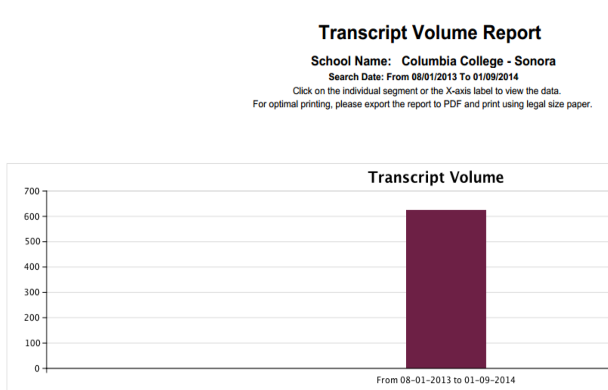
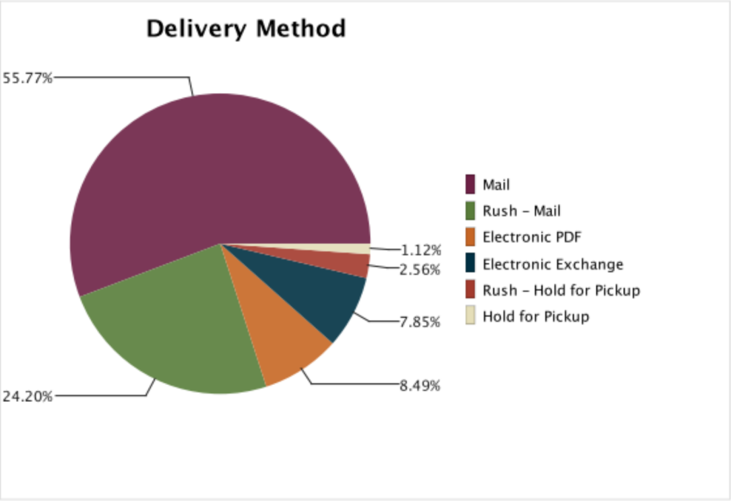

Slide 21
Student Planning
Benefits:
Student access to their progress (Degree Audit)
Online semester planning linked to class schedule

Slide 22
Focus Area 2: Strengthen Support for Entering Students
Recommendation 2.5: Encourage students to declare a program of study upon admission, intervene if a declaration is not made by the end of their second term, and require declaration by the end of their third term in order to maintain enrollment priority.

Slide 23
Focus Area 3: Incentivize Successful Behaviors
Recommendation 3.1: The community colleges will adopt system-wide enrollment priorities that:
1. reflect the core mission of transfer, career technical education and basic skills development;
2. encourage students to identify their educational objective and follow a prescribed path most likely to lead to success;
3. ensure access and the opportunity for success for new students; and
4. incentivize students to make progress toward their educational goal.

Slide 24
Priority Enrollment Concept in the
Proposed Title 5, Section 58108 Regulation
Order of Priority:
Ed Code: Active duty military & veteran students* and current and former foster youth* who are new & fully matriculated or continuing in good standing
District flexibility provided to collapse level 1 & 2 if sufficient capacity exists to do so without displacing level 1 students
1
Academic Conditions for :
100 unit threshold
Good standing: not on academic or progress probation for 2 consecutive terms (title 5, 55031)
2
Existing Title 5: New and continuing fully matriculated
EOPS & DSPS students in good standing
Continuing students in good standing and new, fully matriculated students.
District flexibility to set priorities and categories within these groups
3
District flexibility to set priorities and categories for other students
*Education Code section 66025.8 requires community college to grant priority enrollment to any member or former member of the Armed Forces of the United States within four years of leaving active duty. EC 66025.9 requires priority enrollment for current and former foster youth up to, and including, age 24.

Slide 25
Loss of Enrollment Priority
Continuing students would lose enrollment priority if they…
Earned more than 100 units (not including nondegree applicable basic skills and ESL, and special classes)
Are on academic or progress probation for two consecutive terms (as defined by existing title 5 regulations)
Notes:
Points to make:
Registration priority specified in subdivision (c) of this section shall be lost at the first registration opportunity after a student
Districts may set the unit limit lower than 100 units and may consider units from other higher education institutions.

Slide 26
Exemptions & Appeals
Exemptions: Districts may exempt categories of students or units from the 100 unit limit. For example:
High unit majors or programs
Units earned through credit by exam, Advanced Placement, IB, etc…
Appeals: Districts must adopt an appeals policy and process for students who:
Lose enrollment priority due to extenuating circumstances
Are disabled and who applied for but did not receive timely reasonable accommodation
Districts may also allow appeals for students who demonstrate “significant academic improvement” in a subsequent term

Slide 27
Focus Area 3: Incentivize Successful Behaviors
Recommendation 3.2: Require students receiving Board of Governors (BOG) Fee Waivers to meet various conditions and requirements:
(A) Identify a degree, certificate, transfer, or career advancement goal;
(B) Meet institutional satisfactory progress standards to be eligible for fee waiver renewal; and
(C) Have a transcript that reflects no more than 110 units, not including basic skills and ESL courses.

Slide 28
SB 1456 and the BOG Fee Waiver
Will mirror Enrollment Priority regulations:
Rely on existing academic (2.0) and progress (50%) standards in 55031(a) and (b)
Loss of fee waiver eligibility after two consecutive terms on probation (some discussion needed about how to treat summer terms)
Single appeal process for loss of enrollment priority and loss of BOGFW

Slide 29
Possible Timeline for Fee Waiver Regulations
Proposed regulations to Board of Governors (BOG) May, 2013
Adoption of regulations by (BOG) July, 2013
Begin consumer information dissemination and notification 2013-14 and 2014-15 – first official notification after spring 2014
Make system changes during 2014-15 to allow for single term fee waiver award
First loss of fee waiver anticipated fall 2015 – districts may not implement early

Slide 30
Focus Area 8: Align Resources with Student Success Recommendations
Recommendation 8.2: Invest in a student support initiative

Slide 31
Funding Formula for 2013-14 and 2014-15
Allocations based on existing Matriculation formula:
2.4 X new credit students plus 1.0 X continuing credit students
Each college receives at least 95% of prior year’s credit allocation (if budget allows)
Minimum guaranteed base allocation of $50,000 for small colleges
Credit enrollment headcount based on prior year MIS data
Match requirement of 3:1
Notes:
Formula in place prior to implemented of Categorical Flexibility 2009-10

Slide 32
SB 1456 Student Success and Support Program Credit Funding Formula
College’s Potential Population of Students to Receive Services
Students Served at the College
College Match
Initial Orientation (SS06)** 10%
Initial Assessment (SS07)** 10%
Abbreviated SEP (SS09)** 10%
Counseling/Advising (SS08) 15%
Comprehensive SEP (SS09) 35%
At Risk Follow-Up Svc (SM10) 15%
Other Follow-Up Svc (SM11) 5%
3:1***
Unduplicated Credit Student Headcount*
(academic year =
summer, fall, winter, spring)
Base Funding
Floor $35K or 10%
(whichever is greater)
40%
**Include pre-enrollment services provided for students with SB record
*Includes CA resident students enrolled as of census in at least 0.5 credit units, (STD7) headcount status
“A,” “B,” “C,” excludes special admits
60%
***Match may include A&R, & SSSP related technology & research

Slide 33
Student Success Act of 2012 (SB 1456) Student Success & Support Program Implementation Timeline
Fiscal Year 2012-2013
Fiscal Year 2013-2014
Fiscal Year 2014-2015
Fiscal Year 2015-2016
Fiscal Year 2016-2017
System-level Planning Year:
Implementation workgroups convened October 2012 to develop proposals for title 5 Matriculation revisions, new allocation formula, & revised MIS data elements & definitions
New program planning & budget process developed
SB 1456 effective January 1, 2013
Complete
District/College-Level Planning Year:
Develop program plans
Implement MIS changes & ensure accurate & complete data reporting
Funding targeted to core services of orientation, assessment, counseling & advising, & other education planning services
Allocations remain consistent as prior year, new formula not applied (95% guarantee)
District/College-Level Implementation Year 1:
Program plans & budgets submitted
Continue to ensure accurate & complete data reporting
Legislative implementation report due July 1, 2014 (biannually thereafter)
Proposed student notification requirement Spring 2015
Allocations remain consistent as prior year, new formula not applied (95% guarantee)
Implementation Year 2:
FY 15-16 allocations based on 14-15 year-end data reported
Fall 2015: Proposed requirement of mandated services for first time students
Application of funding formula beginning this year (80% guarantee)
Implementation Year 3:
Legislative report due July 1, 2016
FY 16-17 allocations based on 15-16 year-end data reported (50% guarantee)

Slide 34
Summary of Student Impact
Required assessment, orientation & advisement
Required declaration of program of student
Required Educational Plan
New priority registration rules
Fully Matriculated
Good Academic Standing
Less than 100 units
New BOGFW restrictions

Slide 35
Closing Thoughts…
As we implement policy changes …
Keep the dialogue focused on what works for students
Think about how can we incentivize student and institutional behaviors to increase student success
Be mindful of equity impacts… need to track student outcomes- especially for underrepresented and educationally disadvantaged student groups…
College-wide Efforts!

Slide 36
So Now What?
SSSP workgroup to determine:
Examine orientation, assessment, counseling/SEP
Considerations: sequence of delivery, scalability, increasing access, methodologies, use of technology
IT interfacing considerations
Scheduling software (SARS) and student record system (Datatel)
MIS redesign implementation plan

Slide 37
Want to help or just want more information?
Chancellor’s Office website: www.cccco.edu
Flex Day Breakout sessions: Friday, Jan 10, 10:45 am
Orientation & Assessment
Education Planning
Academic Follow-Up
Feedback: questions, comments, suggestions
Index cards
Survey Monkey
Columbia College SSSP workgroup

Slide 38
Columbia’s SSSP Workgroup
Melissa Raby
Chris Vitelli
Randy Barton
Diana Sunday
Colleen Henry
Shawn Jordison
Matt Christman
John Leamy
Elizabeth Pfleging
Courtney Castle
Rick Rivera
Adrienne Seegers
Tina Troiler
Karin Rodts

