Slide 1

Advanced ISER Training Sept. 9, 2022 Dr. Catherine Webb ACCJC Vice President & Staff Liaison to Columbia College

Slide 2

Topics for Today
Good Practices & Tips for the ISER
Overview: Timeline & Process for Comprehensive Review
Your Questions
Notes:
Catherine’s not so secret goal for today: help you re-energize for the “back half” of your ISER marathon

Slide 3
Quick Refresher: Accreditation 101
Accreditation is a practice of academic quality control
Promotes institutional excellence through application of standards
Advances meaningful and effective student learning and achievement
Provides assurance to students, general public, & others of quality of educational offerings
Using processes characterized by a unique commitment to peer review
Comprehensive evaluations are practitioner-based and mission-focused
Consistent Standards for quality, implemented by different types of institutions
With immediately practical benefits
Enables access to Title IV programs (Federal Student Aid)
Ensures creditability of degrees and credentials awarded to students

Slide 4

Powerful Framework for Ongoing Improvement
Power of Self-Reflection
Power of Peer Review
Power of Accredited Status

Slide 5
The ISER: Good Practices & Tips for Putting It Together

Slide 6
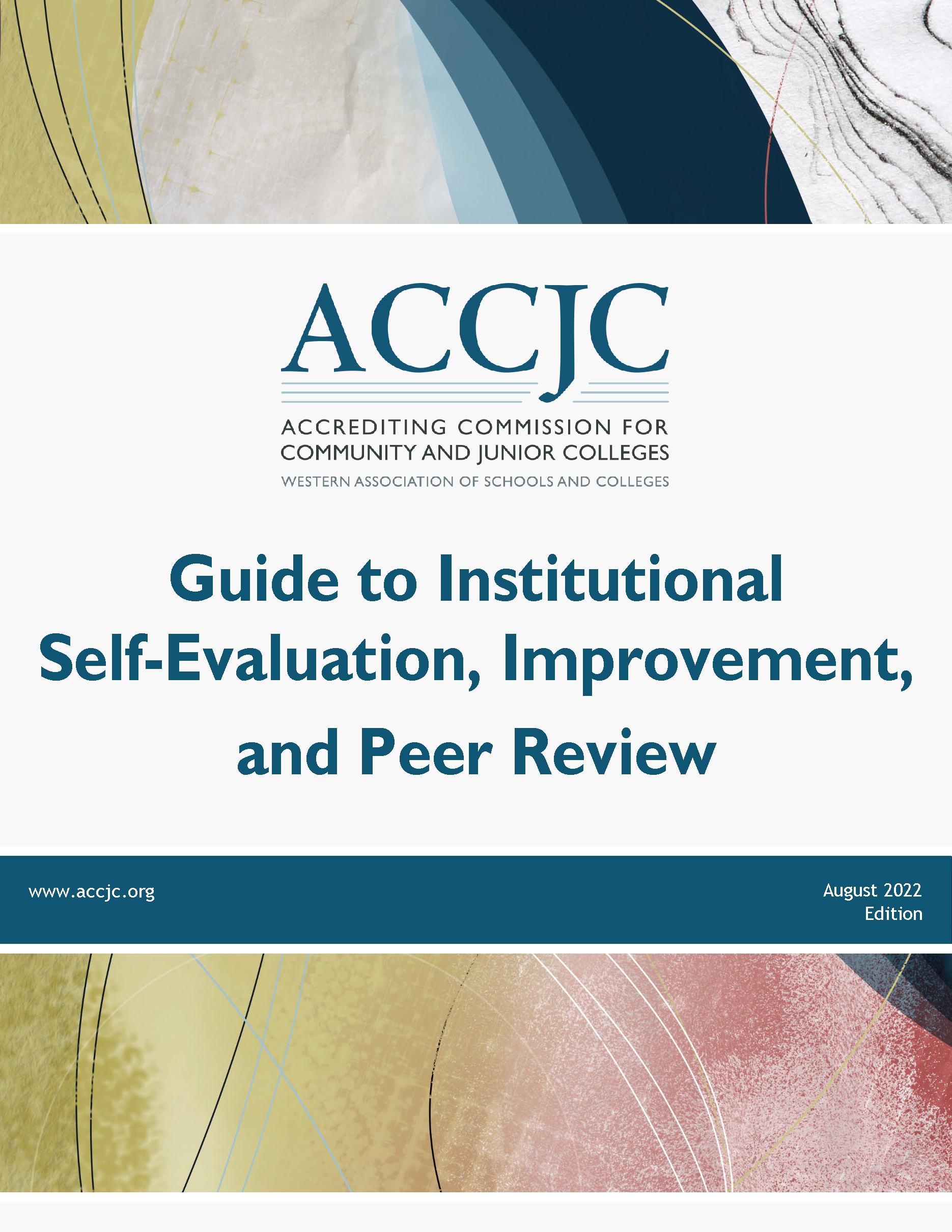
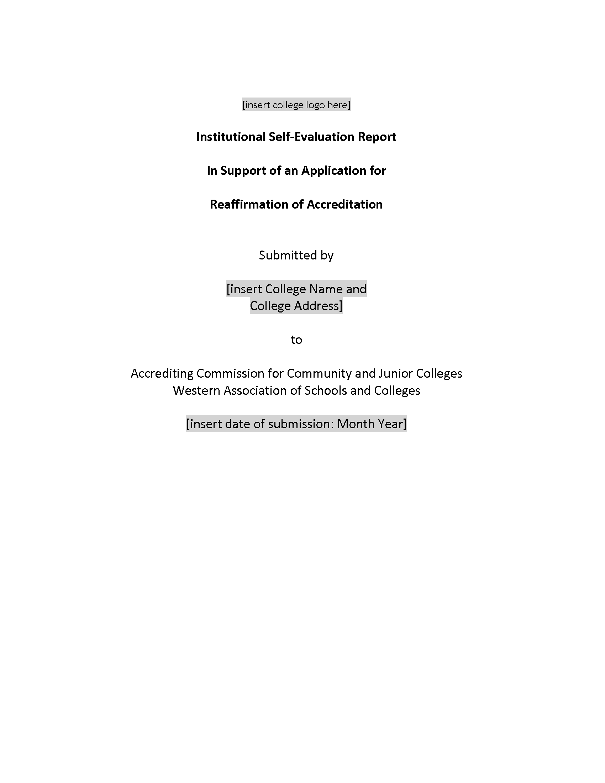
Key Resources:
Guide to Institutional Self-Evaluation, Improvement, and Peer Review
Required contents, formatting/structure suggestions, submission instructions, additional protocols, etc.
ISER Template
Word document with embedded formatting, structure, links to the Guide, etc.
Available on ACCJC website – Resources > Guides & Manuals

Slide 7
Good Practices for Approaching the Report
Discuss the Standard, gather the evidence, then write
Refer to the Guide to Institutional Self-Evaluation frequently
Keep the narrative clear, direct, and focused – use active voice
Use introductory sections to set the context and tone
Don’t forget narratives for ERs 1-5 & Commission Policies!
Work with colleagues from sister college & district on shared sections
Use the ISER template (available on ACCJC website)
Format as an electronic document from the start

Slide 8
Good Practices for Evidence
Gather your evidence before you begin writing
Compare your evidence with suggestions in the Guide
Be selective: more evidence is not necessarily better
Provide samples that show results of institutional processes
Call out relevant sections of big documents (highlights, excerpts, etc.)
“Freeze” evidence from websites in a PDF or screenshot

Slide 9
Advice for the Report Based on Recent Reviews
Evidence + Narrative should show your practices in action
Provide completed examples, not just process handbooks or templates
Balance examples across different areas of the institution
Tell the whole story of complex processes
Outline multi-step/integrated processes with clear description or visuals
Include “case studies” showing how steps fit together
Check your cycles (e.g., assessment, evaluations, BP review)
Are you on schedule and at expected completion percentages?
If you’ve slipped, include plans to get back on track in your evidence

Slide 10
Reflect & Self-Assess as You Go
Questions to consider as you review your drafts:
Is the narrative accurate?
Have we met the review criteria in the Guide?
Does each response include appropriate evidence?
Is our narrative focused ONLY on the Standard?
Do we call out both strengths and areas of improvement?
Do we have action plans and timelines for major areas of improvement?

Slide 11
Comprehensive Review: Timeline and Process

Slide 12
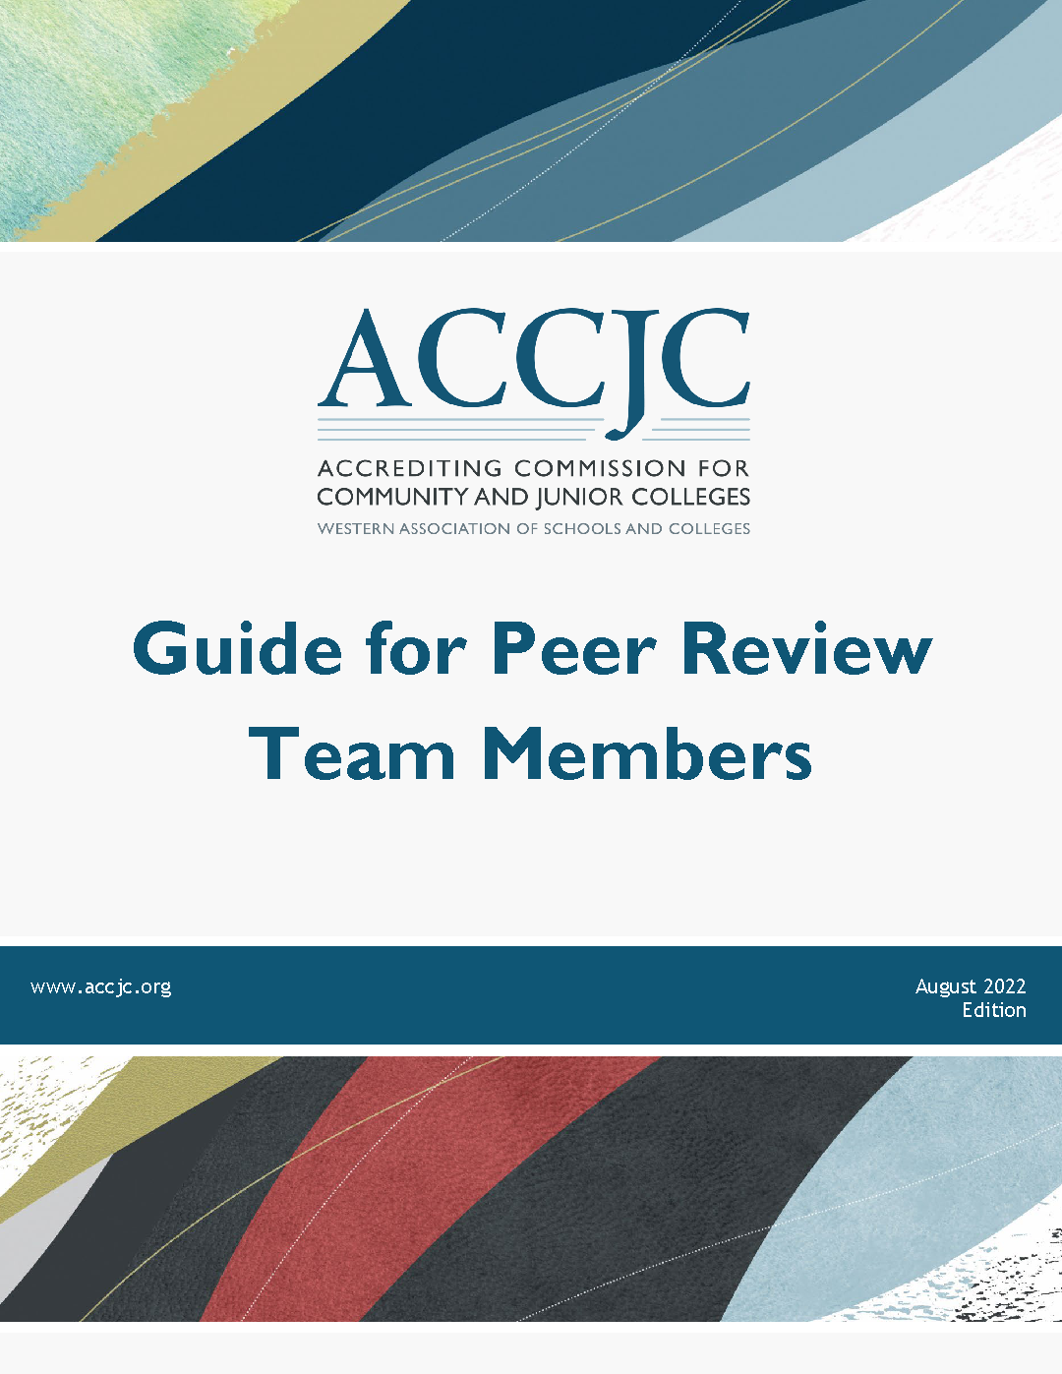
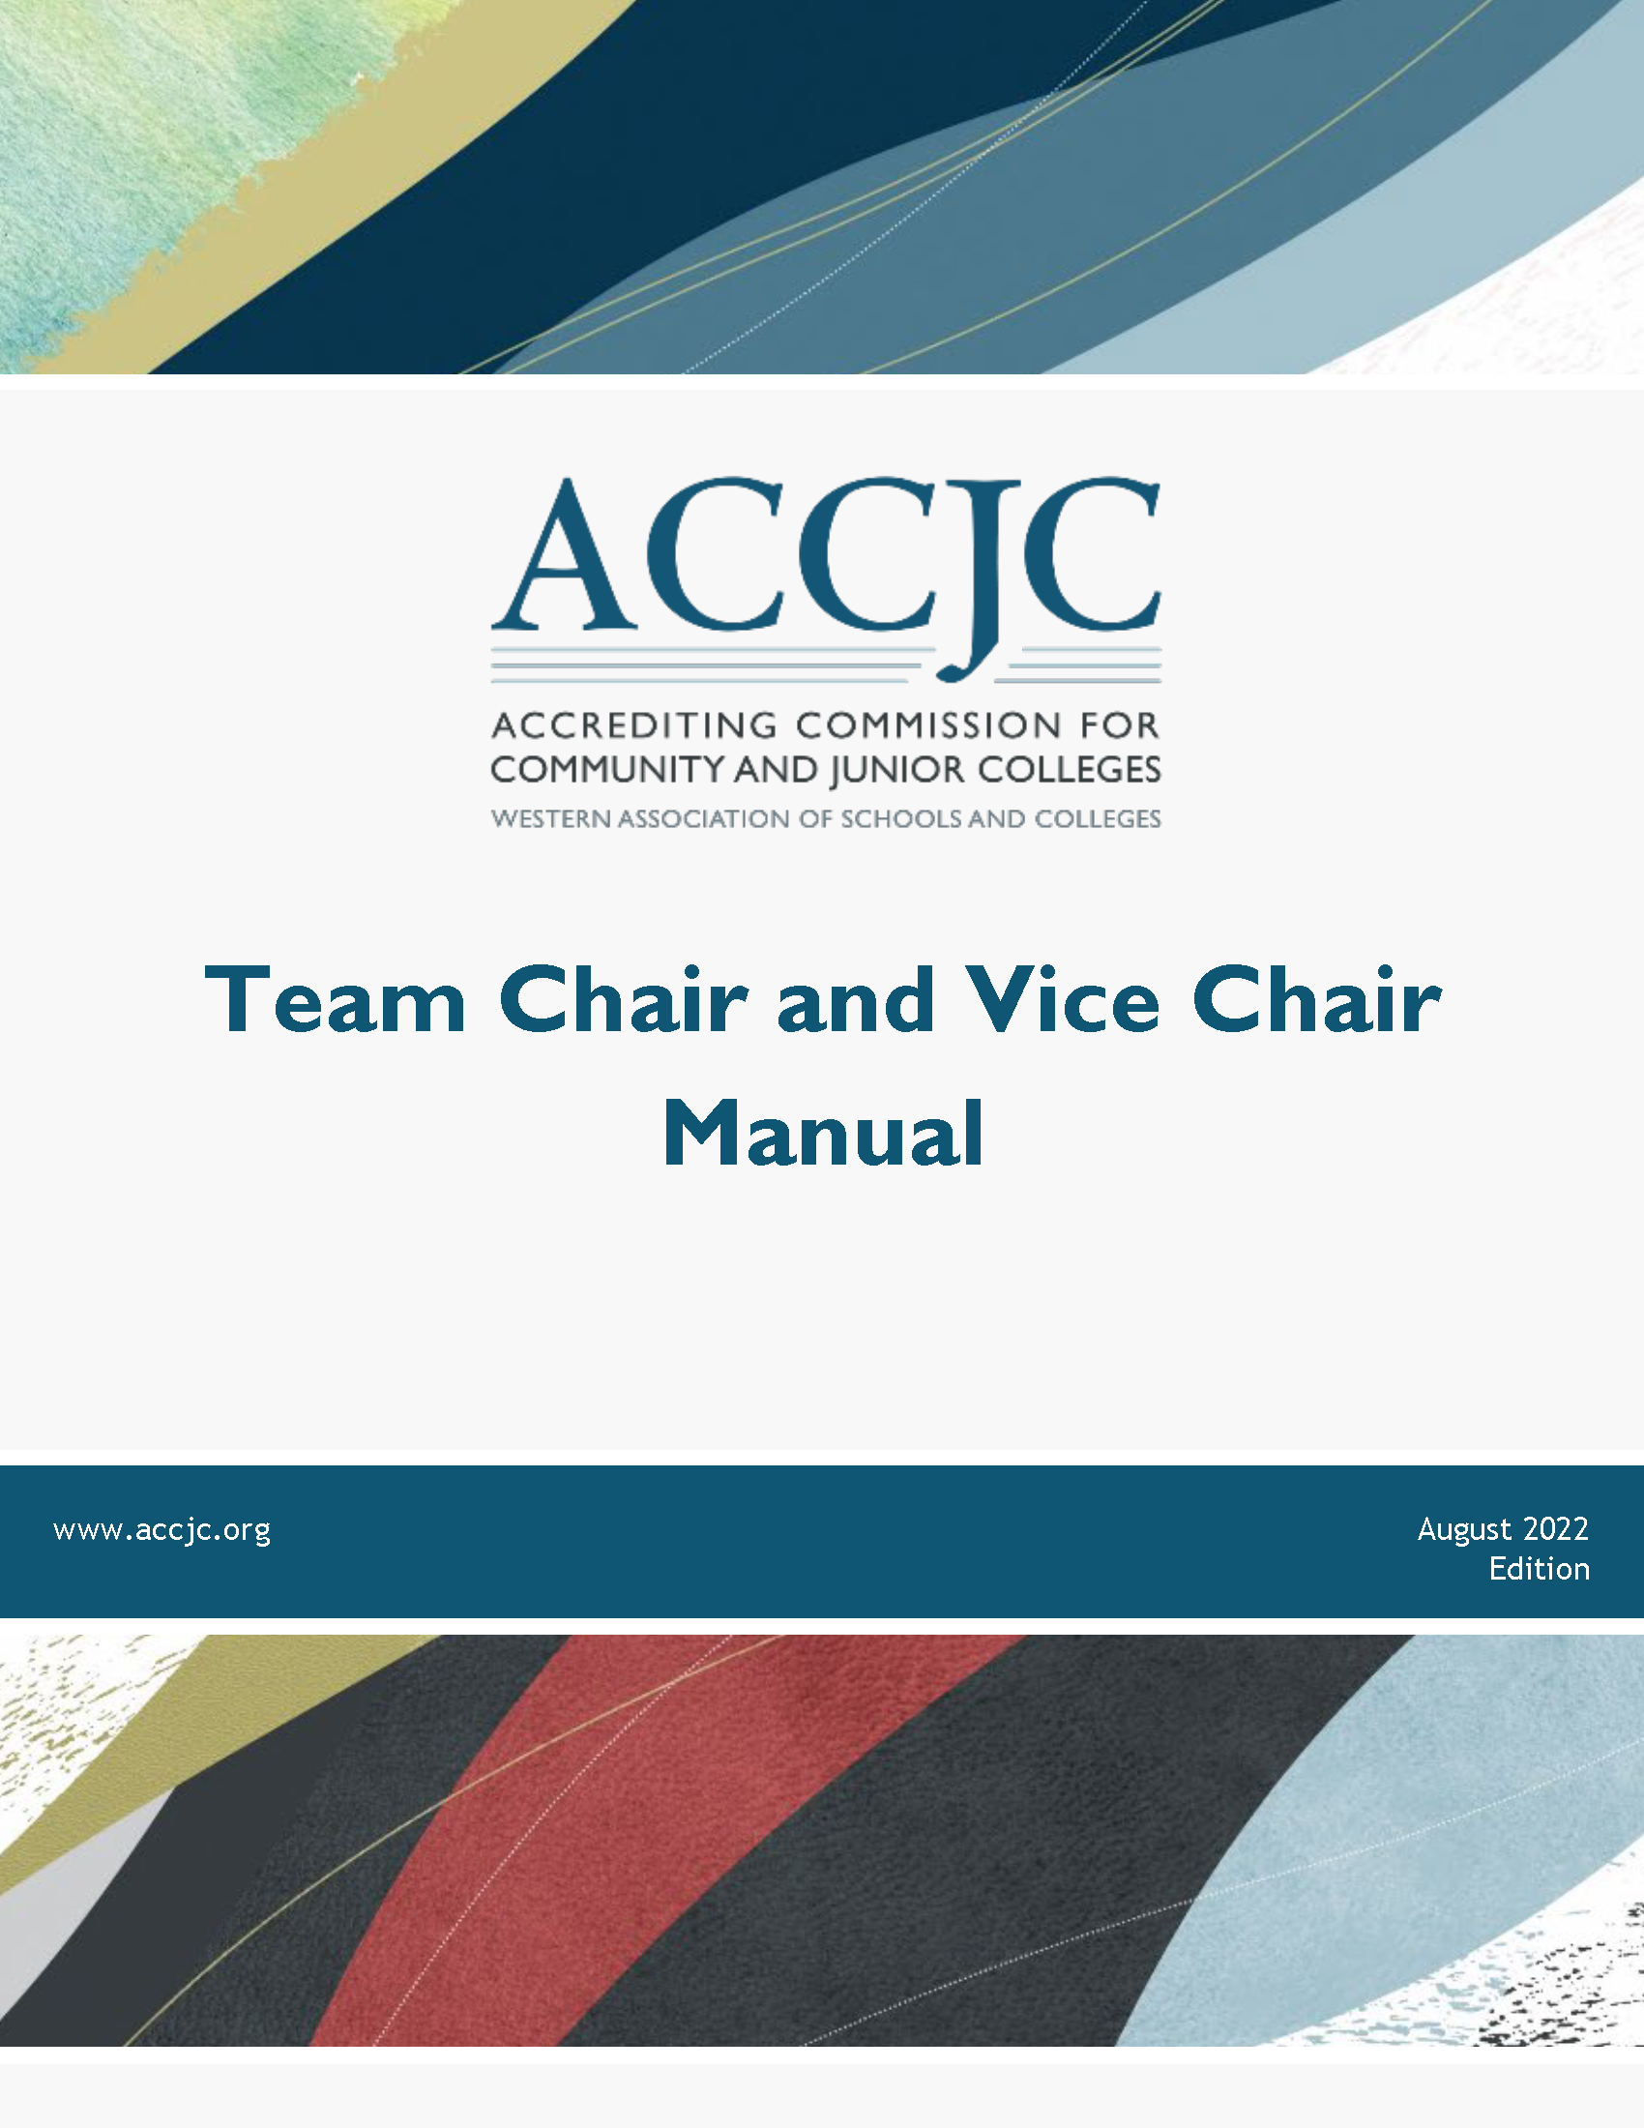
Key Resources:
Guide for Peer Review Team Members
General principles; team instructions; expectations for colleges; guidelines for DE review, etc.
Team Chair and Vice Chair Manual
Suggested Timeline, Pre-visit meeting agendas, Schedules for team activities, etc.
Available on ACCJC website: Resources > Guides & Manuals

Slide 13
Timeline for Your Comprehensive Review
Date | Activity
December 15, 2023: | ISER & evidence due to ACCJC
Spring 2024: | Team ISER Review Peer Review Team provides formative feedback via Core Inquiries
Fall 2024: | Focused Site Visit Subset of Peer Review Team visits, conducts interviews Peer Review Team provides summative feedback via Team Report
January 2025: | Commission Action

Slide 14
Closer Look: Two-Semester Peer Review Process
Self-Review (Self-Evaluation)
Peer Review (Team ISER Review & Focused Site Visit)
Commission Review Decision & Action
Team ISER Review (Spring 2024)
Conducted away from Campus
Establishes Lines of Inquiry for Visit
Result: Core Inquiries Report
Focused Site Visit (Fall 2024)
Final Validation of Standards
Resolution of Inquiries
Result: Peer Review Team Report
College Prep Time

Slide 15
Benefits of the Two-Semester Review Process
Reduces surprises during the Focused Site Visit
Reduces fear and anxiety
Gives you time to consider the team’s questions and make changes
Emphasizes institutional improvement and ongoing learning
Promotes collegiality between you and your peer review team
Increases transparency and trust around the review process

Slide 16
Activities in the Comprehensive Review Process
Team ISER Review (Fall 2023)
Associated Activities: | Purpose Is To: | Results In:
“Kick-Off” with College Open Forum 1-day off-site team meeting | Validate Standards that are met based on ISER Identify Standards where clarification is needed for potential recommendation or commendation Develop the core inquiries for the Focused Site Visit | Core Inquiries Report

Slide 17
Activities in the Comprehensive Review Process
What’s in the Core Inquiries Report?
One or more Core Inquiries, each consisting of:
Summary-level information | 1-2 sentence summary of the area for clarification or further discussion Specific indication of relevant Standards or Policies for the inquiry
Detail about Team’s observations | Brief description of what the team observed during review of ISER and evidence Clear identification of the area that needs clarification or exploration
Items to address at the Focused Site Visit | Short list of topics the team would like to discuss during interviews Requests for any additional information or evidence Interview requests

Slide 18
Activities in the Comprehensive Review Process
What does the college do with the Core Inquiries Report?
Prepare for the Focused Site Visit:
Review and reflect on the Core Inquiries Address any obvious/easy items (e.g., missing policies/procedures) Document all progress in areas connected Core Inquiries Gather additional evidence Prepare “College Update to Core Inquiries” (due 2 weeks before visit)

Slide 19
Activities in the Comprehensive Review Process
Focused Site Visit (Spring 2024)
Associated Activities: | Purpose Is To: | Results In:
Visit by subset of team Interviews Open Forum Team meetings Exit Report | Validate Standards that are met based on ISER, interviews, and additional evidence Finalize any team recommendations or commendations Complete the draft Peer Review Team Report outlining the findings of the team | Peer Review Team Report

Slide 20
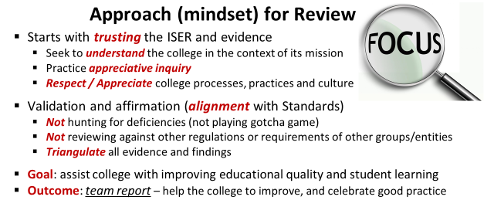
Excerpted from Team Training materials, Fall 2022

Slide 21
Checking In:
Any remaining questions?
What additional information or resources would be helpful?

