Slide 1


Board Study Session
November 1, 2022
Columbia College Accreditation Tri-chairs
Raelene Juarez, Elissa Creighton, and Colin Thomas
and
Modesto Junior College Accreditation Co-chairs
Patrick Bettencourt and Chad Redwing

Slide 2

Framework for Ongoing Improvement
Power of Self-Reflection
Power of Peer Review
Power of Accredited Status
Notes:
Colin

Slide 3
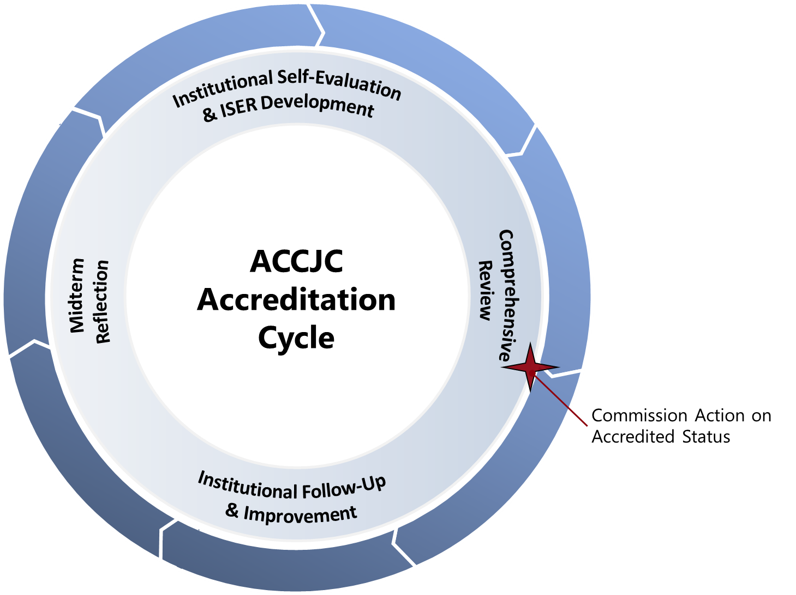
ACCJC’s Accreditation Cycle & Reports
Reports at a Glance:
Institutional Self-Evaluation Report (ISER) (Required for all members every 7 years)
Follow-Up Reports
(Only when required by the Commission)
Midterm Reports
(Required for all members 4th year after comp review)
Annual Report and Annual Fiscal Report
(Required for all members on an annual basis)
Substantive Change
(Required for all members under specific circumstances)
Notes:
Patrick
-accreditation based on 7 year cycle
-institution conducts its own self evaluation and then validated by peers
-process designed to help institutions improve and focus on effective institutional processes and improving student outcomes
-throughout 7 years, monitoring activities
touchpoint mid-cycle
Ongoing monitoring of certain aspects of institutional quality (per federal regulations)
Fiscal Health
Headcount growth or decline
Substantive Changes
-accreditation reviews are based on ACCJC accreditation standards, applied in context of the institution’s mission

Slide 4
Accreditation Timeline
Summer/ Fall 2022
Align standards and training to Self-Study teams
Spring 2023
Quality Focus Essays and ISER drafted and first read through governance bodies
Fall 2023
Second reading by governance bodies
ISER draft reviewed by Board of Trustees
Spring 2024
ACCJC Team ISER Review and final edits and corrections
Fall 2024
ACCJC site visit
ACCJC Advanced ISER Training and teams begin gathering evidence and reviewing criteria
Accreditation Council ensures that analysis and evidence worksheets are complete
ISER due to ACCJC December 15, 2023
ACCJC Commission action January 2025
Notes:
Patrick

Slide 5
Quick Review: Accreditation 101
Accreditation is a practice of academic quality control
  Promotes institutional excellence through application of standards
  Advances meaningful and effective student learning and achievement
  Provides assurance to students, general public, & others of quality of educational offerings
Using processes characterized by a unique commitment to peer review
  Comprehensive evaluations are practitioner-based and mission-focused
  Consistent Standards for quality, implemented by different types of institutions
With immediately practical benefits for students
Enables access to Title IV programs (Federal Student Aid)
Ensures creditability of degrees and credentials for transfer and employment
Encourages institutional innovation in response to changing student needs
Notes:
Chad

Slide 6

Intended Outcome for the Self-Evaluation
The goal is an Institutional Self-Evaluation Report (ISER) that:
Reflects an authentic, collaborative, and mission-focused self-evaluation
Demonstrates how your college:
  Aligns with Standards
  Exemplifies academic quality
  Continues to learn and improve
Serves as a framework for fostering ongoing institutional
excellence and student success
Notes:
Chad
Comes together through collaborative partnership – multiple stakeholder groups working together to reflect on institutional strengths and areas of improvement as you apply accreditation standards

Slide 7
Based on Four Interconnected Standards
Standard I
Standard II
Standard III
Standard IV
Mission, Academic
Quality & Institutional Effectiveness, & Integrity
Student Learning Programs & Services
Resources
Leadership & Governance
Mission
Instructional Programs
Human Resources
Decision-Making Roles & Responsibilities
Physical Resources
Chief Executive Officer
Assuring Academic Quality & Institutional Effectiveness
Library & Learning Support Services
Technology Resources
Governing Board
Institutional Integrity
Student Support Services
Financial Resources
Multi-College Systems or Districts
Notes:
Chad

Slide 8
Key Concepts Woven Throughout Standards
Focus on achieving institutional mission
Integrity and honesty in institutional policies and actions
Focus on student outcomes
  Student achievement: Completion of meaningful educational goals
  Student learning: Attainment of demonstrable knowledge and skills
Metrics and evidence used to assess institutional quality
Ongoing internal quality assurance practices
Continuous improvement for high performance
Notes:
Chad

Slide 9
Standard IV – Leadership & Governance
Standard IV
Standard IV.A: Decision-Making Roles & Responsibilities
  Sub-Standards IV.A.1 – IV.A.7 (seven total)
Standard IV.B: Chief Executive Officer
  Sub-Standards IV.B.1 – IV.B.6 (six total)
Standard IV.C: Governing Board
  Sub-Standards IV.C.1 – IV.C.13 (thirteen total)
Standard IV.D: Multi-College Systems or Districts
  Sub-Standards IV.D.1-IV.D.7 (seven total)
Leadership & Governance
Decision-Making Roles & Responsibilities
Chief Executive Officer
Governing Board
Multi-College Systems or Districts
Notes:
Raelene

Slide 10
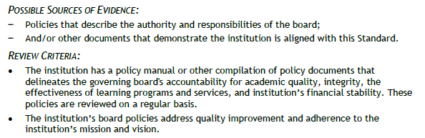
Standard IV.C.1
The institution has a governing board that has authority over and responsibility for policies to assure the academic quality, integrity, and effectiveness of the student learning programs and services and the financial stability of the institution. (ER 7)
Notes:
Raelene

Slide 11
Governing Board: Eligibility Requirement #7
The institution has a functioning governing board responsible for the academic quality, institutional integrity, and financial stability of the institution and for ensuring that the institution's mission is achieved. This board is ultimately responsible for ensuring that the financial resources of the institution are used to provide a sound educational program. Its membership is sufficient in size and composition to fulfill all board responsibilities.
The governing board is an independent policy-making body capable of reflecting constituent and public interest in board activities and decisions. A majority of the board members have no employment, family, ownership, or other personal financial interest in the institution. The board adheres to a conflict of interest policy that assures that those interests are disclosed and that they do not interfere with the impartiality of governing body members or outweigh the greater duty to secure and ensure the academic and fiscal integrity of the institution. (Standard IV.C.1, IV.C.4, and IV.C.11)
Notes:
Raelene

Slide 12
Standard IV.C.1 – Evidence List
BP2410 – Board Policies and Administrative Procedures
Board Policy and Procedures – website
YCCD Board Policies and Administrative Procedures – review process
Specific Evidence
  academic quality – review and adopt mission, vision, values, and planning documents (BoardDocs minutes to illustrate)
  integrity - BP2715 – Code of Ethics/Standards of Practice
  effectiveness - BP3225 – Institutional Effectiveness
Other?
Notes:
Raelene

Slide 13
Timeline & Process for Comprehensive Review
Date | Activity
December 15, 2023: | ISER & evidence due to ACCJC
Spring 2024: | Team ISER Review Peer Review Team provides formative feedback via Core Inquiries
Fall 2024: | Focused Site Visit Subset of Peer Review Team visits, conducts interviews Peer Review Team provides summative feedback via Team Report
January 2025: | Commission Action
Notes:
Raelene

Slide 14
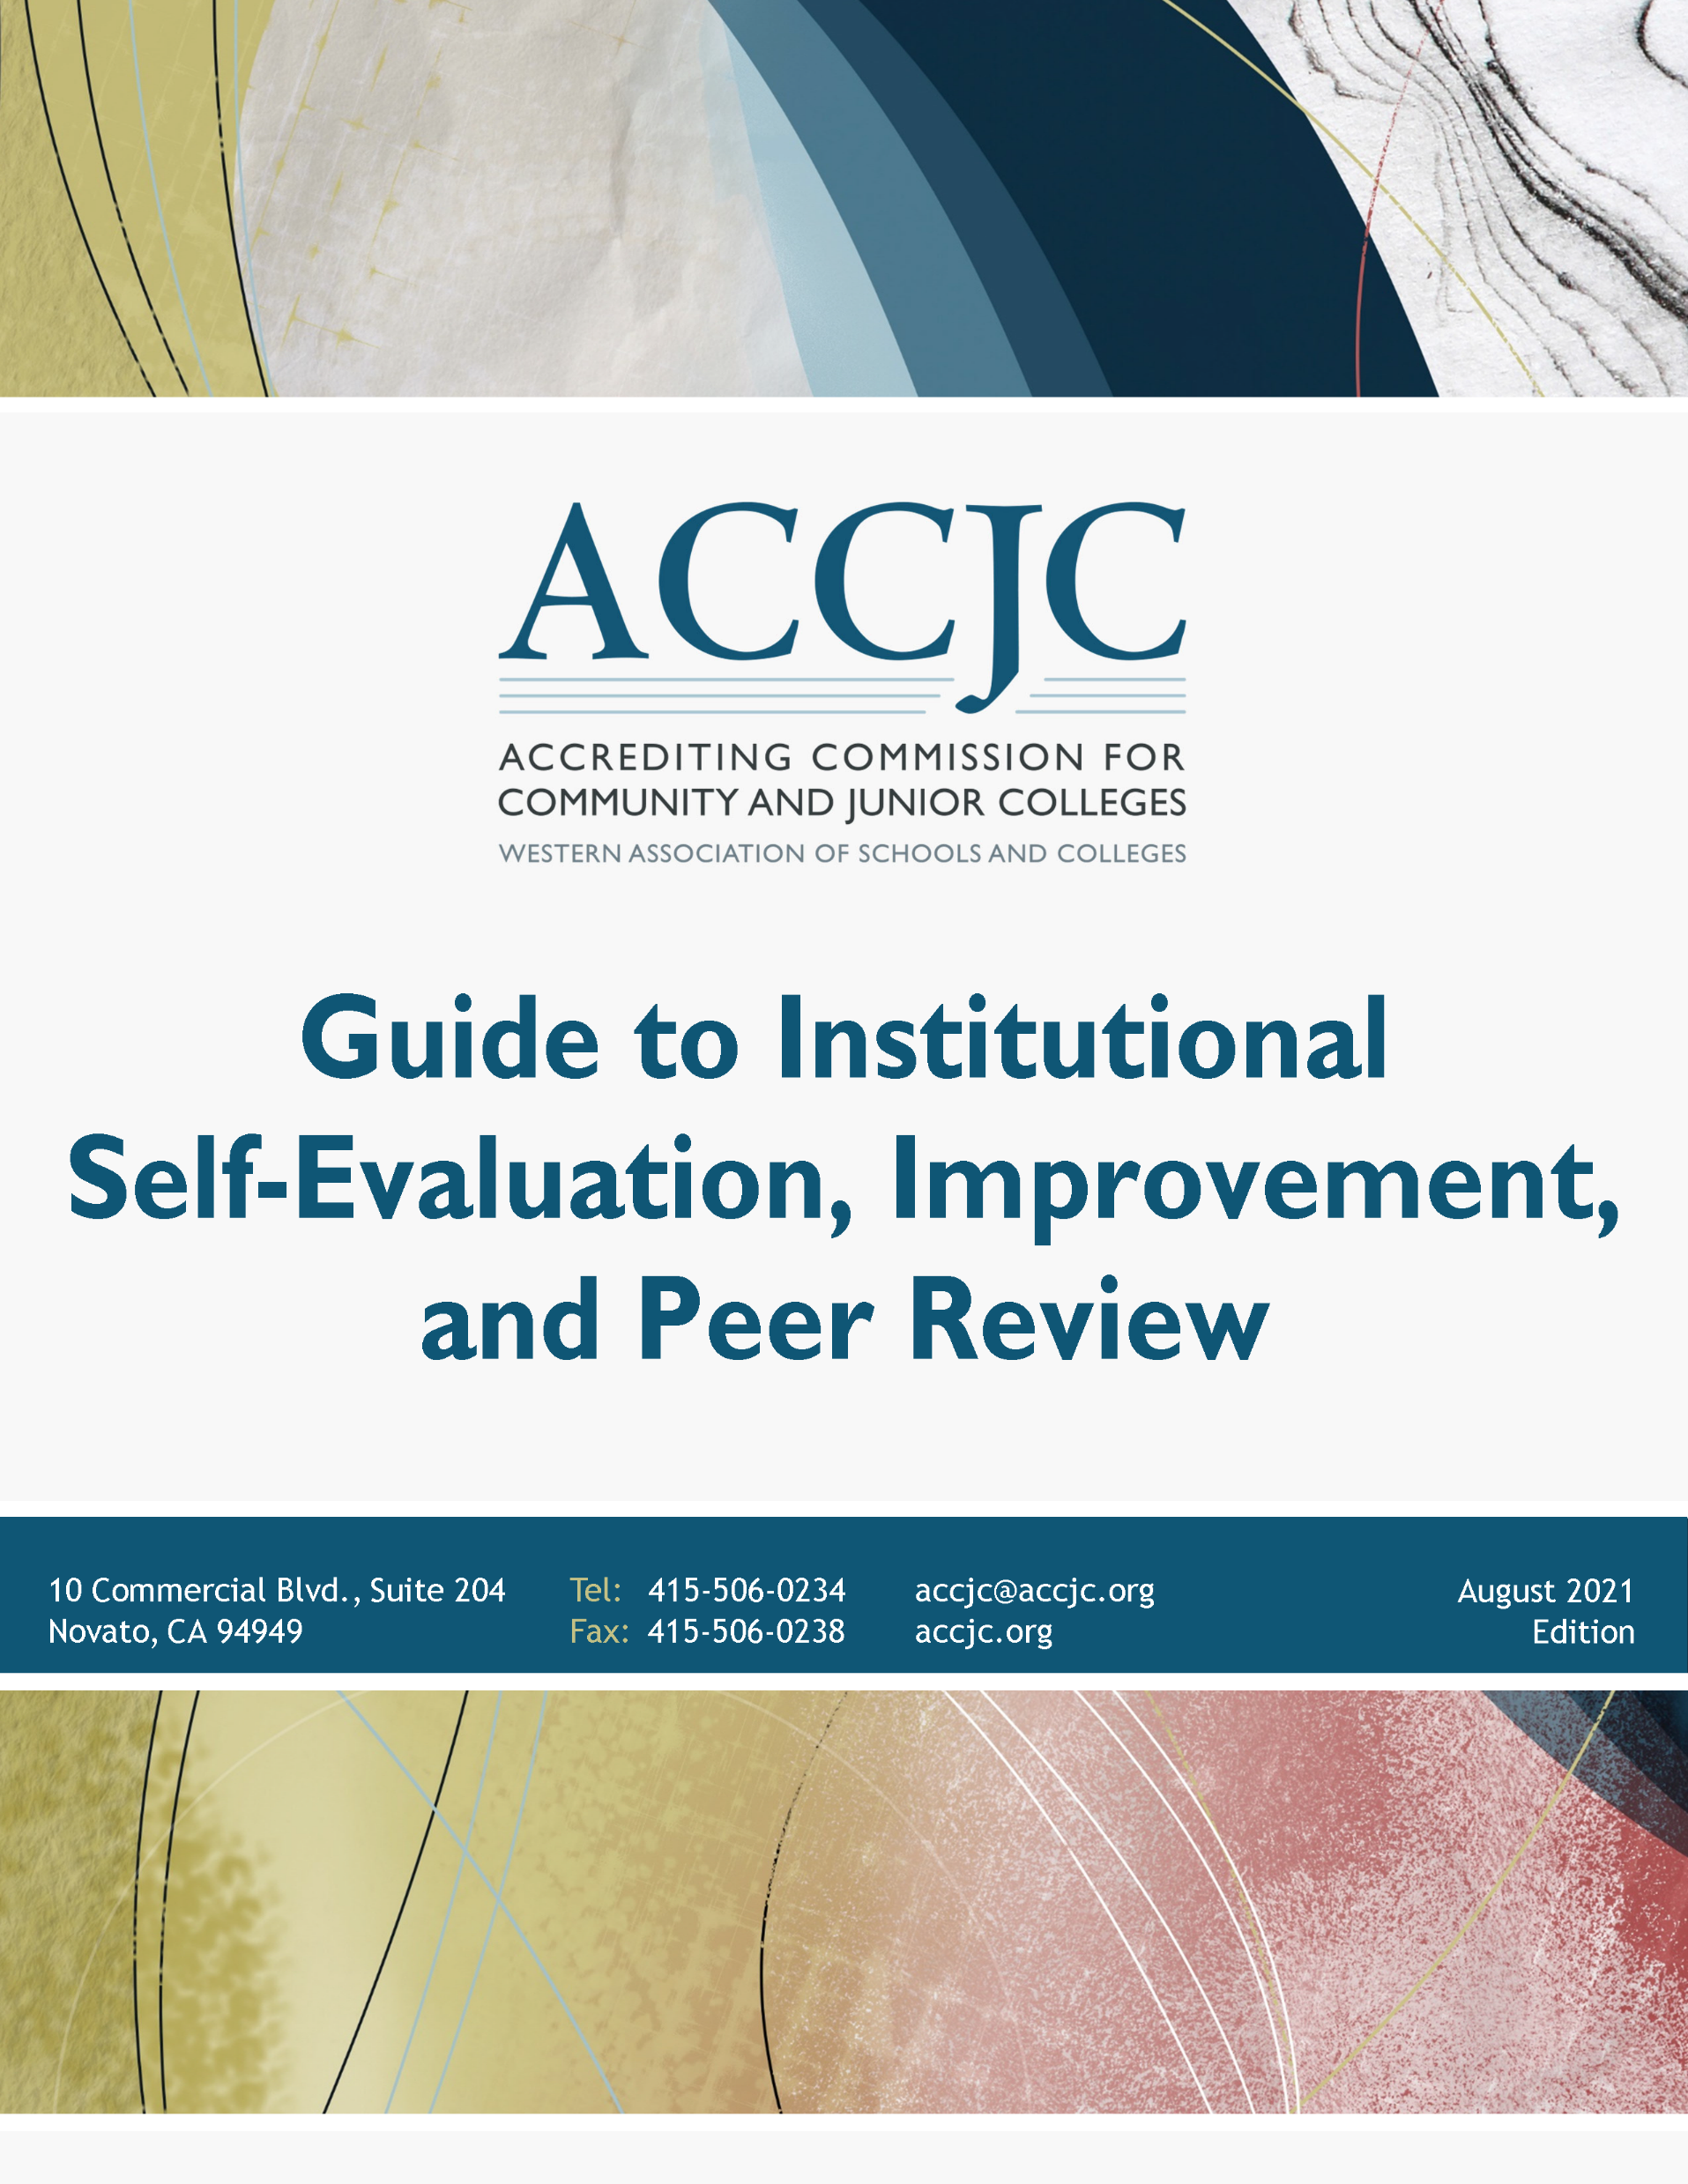
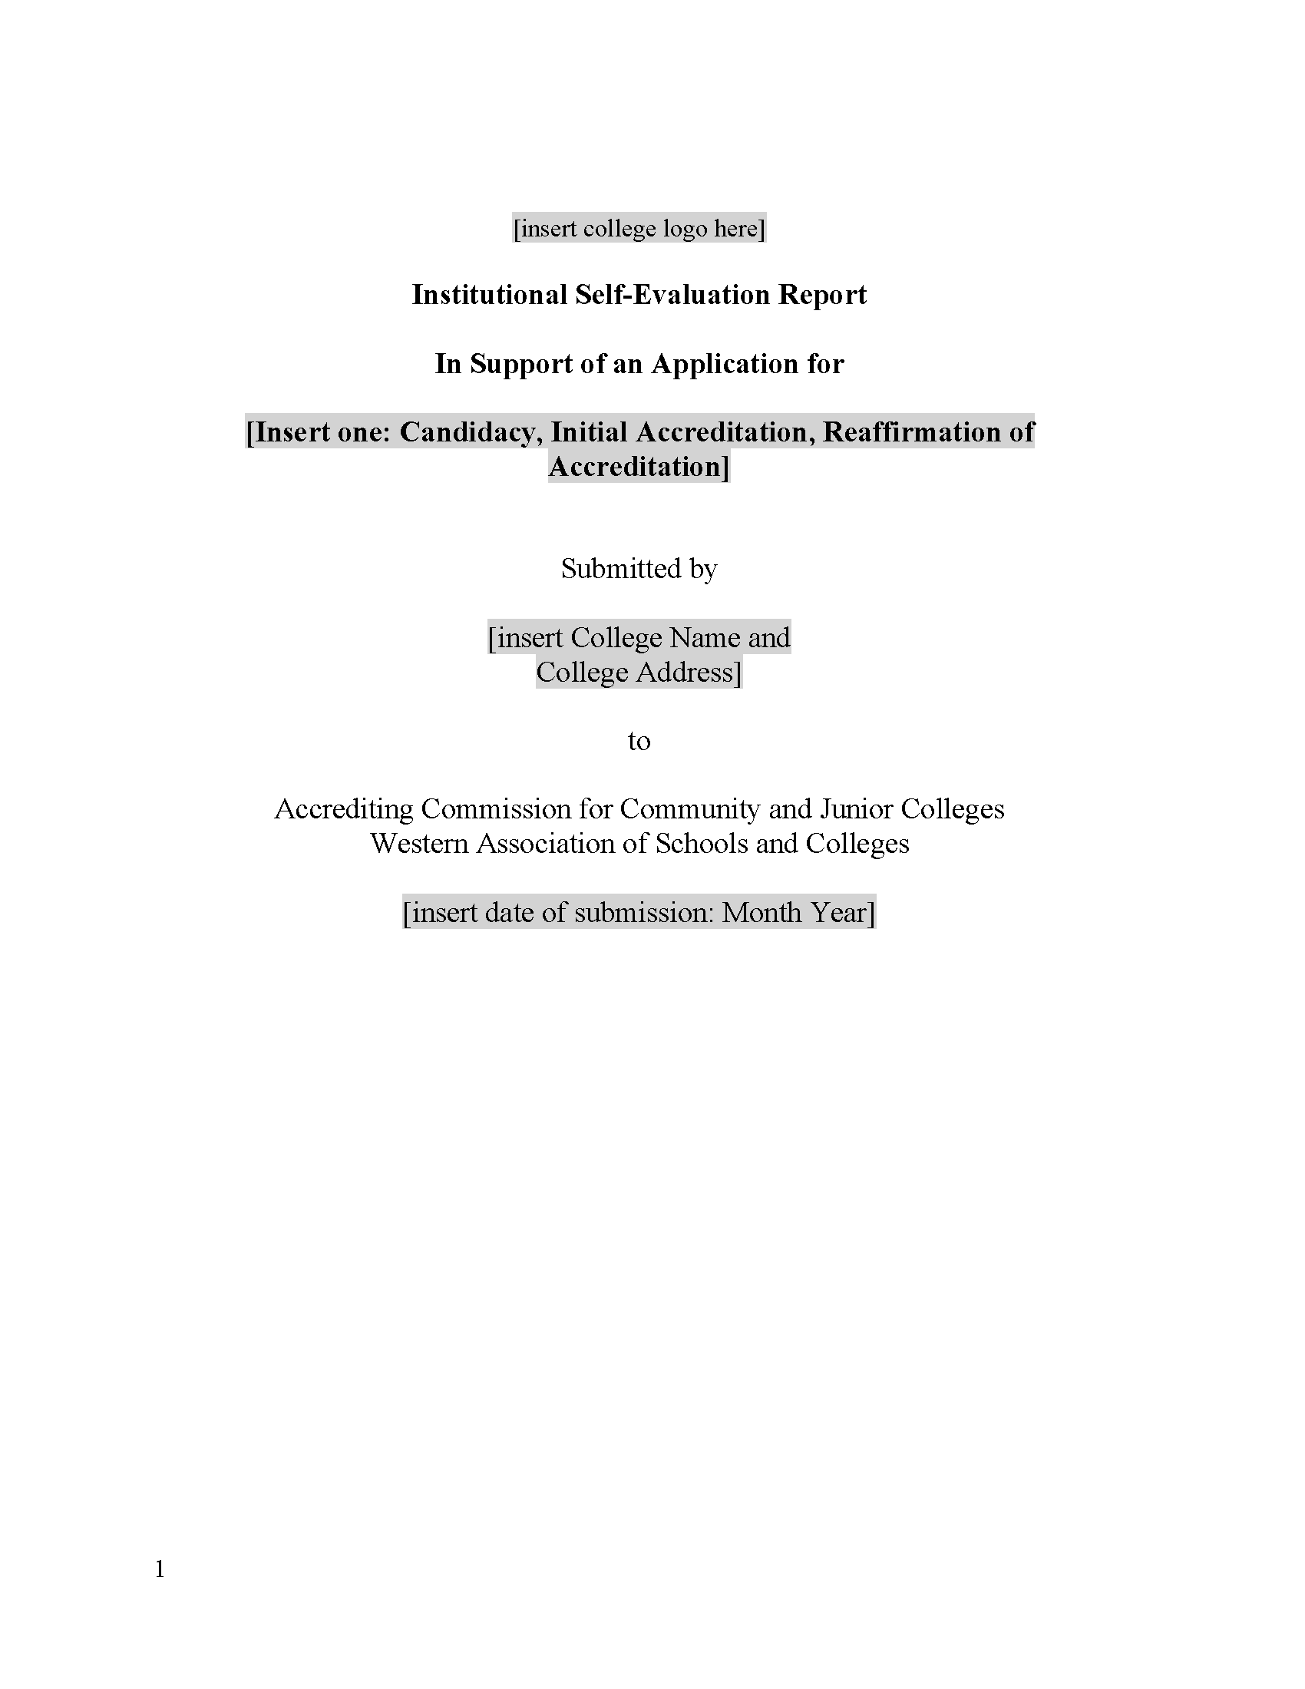
Key Resources
Guide to Institutional Self-Evaluation, Improvement, and Peer Review
  Required contents, formatting/structure suggestions, submission instructions, additional protocols, etc.
ISER Template
  Word document with embedded formatting, structure, links to the Guide, etc.
Available on ACCJC website – Resources > Guides & Manuals
Notes:
Required elements, guidance, submission process, annotated Standards, review criteria, suggestions of possible evidence, “Policy Checklist,” DE protocol, etc.

